Slide 1
Reproductive failure

Slide 2
Human conception and pregnancy is both a vulnerable and a robust process
Vulnerable, in that a large proportion of all conceptions are chromosomally abnormal, with the great majority of such pregnancies aborting
Robust, in that more than 99% of the time, a term pregnancy results in a chromosomally normal baby; unbalanced chromosomal abnormalities are seen in less than 1% of newborns

Slide 3
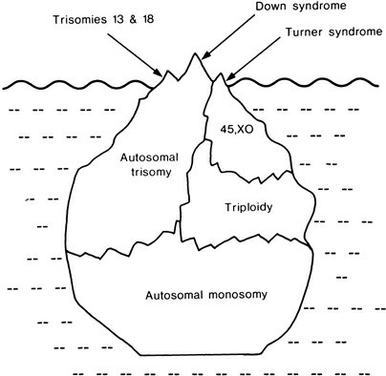
The occasional chromosomally abnormal child is, relatively speaking, an exceptional outcome—the tip of an iceberg
FIGURE 19–1 The iceberg of chromosomal pregnancy loss.

Slide 4
Advances in reproductive technology now enable many otherwise infertile couples to have children
Translocation carriers may have recourse to preimplantation genetic diagnosis (PGD) as a means to improve their chances of achieving a successful pregnancy
In the case of men with poor sperm production, intracytoplasmic sperm injection (ICSI) at in vitro fertilization (IVF) is a means to get a single sperm into an egg

Slide 5
An aneuploid gamete (nullisomic or disomic) will lead to an aneuploid conceptus (monosomic or trisomic)
A diploid gamete, combining with a normal gamete, will give rise to a triploid conceptus
Dispermy (two sperm fertilizing the one ovum) can cause triploidy
An abnormal postzygotic cell division can give rise to mosaicism
These several possibilities all add up to a substantial potential for chromosome abnormality in the very early conceptus, in the first days (even hours) of existence

Slide 6
The cleavage embryo (“Pre-embryo”) (days 1–3)
A study of more than 22,000 day-3 embryos tested using SNP microarray, found proportion of aneuploid embryos remained fairly constant at 65% between maternal ages 27 and 35 years, but increased markedly at older ages

Slide 7
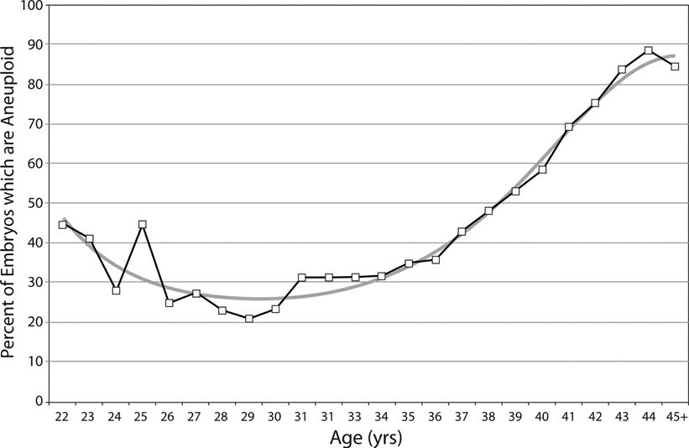
The morula and blastocyst (Days 4-5)
A study analyzed more than 15,000 embryos of parents presenting at IVF/PGD for trophectoderm biopsy. The least aneuploidy rate was in the 25- to 34-year-old age group, and progressively increasing steeply from age 35 years to the mid-forties

Slide 8
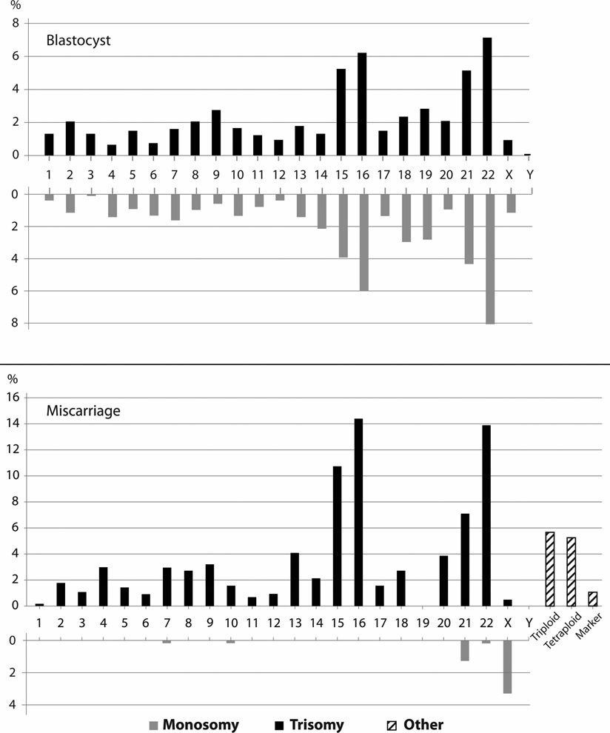
A study of 1,000 embryos subject to trophoectoderm biopsy at day 5/6, for preimplantation genetic diagnosis:
Frequencies of trisomy and monosomy per chromosome are similar, albeit that rates between different chromosomes differ greatly
At miscarriages, spread of trisomies is similar, whereas autosomal monosomies have mostly disappeared, reflecting the differential early pregnancy survival of the two aneuploidy classes

Slide 9
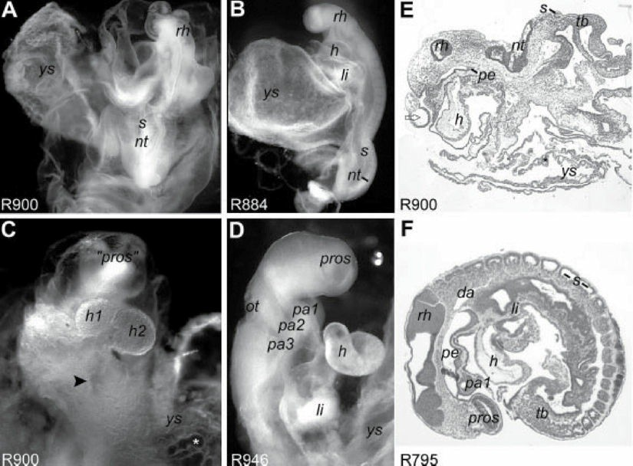
A study examined expelled products following very early elective abortion
One severely malformed embryo at 25 days postconception, failed to develop crucial organs
Trisomy 8 (A, C, E)
Normal (B, D, F)

Slide 10
Of all recognized pregnancies (recognized in the traditional way, that is), approximately 10%–15% end in clinical miscarriage—“spontaneous abortion”—mostly toward the end of the first trimester
In most studies somewhat over a half of abortuses are shown to have a chromosome abnormality

Slide 11
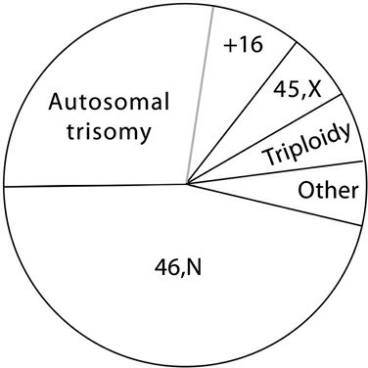
Trisomies account for about two-thirds of all cytogenetic abnormalities identified at spontaneous abortion. The most commonly seen abnormal karyotypes are trisomy 16, monosomy X, and triploidy
FIGURE 19–5 Chromosomal findings in products of conception from spontaneous abortions analyzed by microarray.

Slide 12
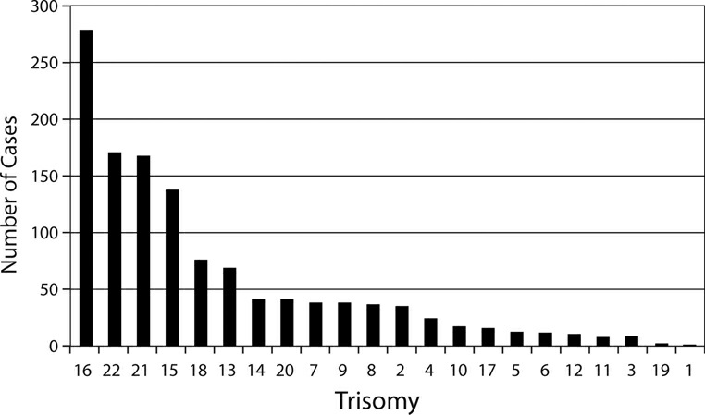
Full range of trisomies, and their relative frequencies
FIGURE 19–6 The relative frequencies of trisomies observed in products of conception, descending from the most often seen (trisomy 16) to the least (trisomy 1). These data are from the 1,872 abnormal results of a series of 5,457 consecutive samples of products of conception, on G-banding analysis. The findings are very similar to those shown in Figure 19–3.

